Slide 1
Data-Driven Intervention:
A High-School Case Study
U.C.E.A., October 29, 2010
Amanda Cassity
Julie Gray
C. John Tarter
The University of Alabama
Notes:
Amanda - What makes for a good school climate – or a “healthy” school? Is it friendly teachers, engaged students, few discipline problems – or are these just evidences of a deeper organizational culture? Visitors to schools have even said they can tell if a school is healthy just by walking into the building. They can “feel” the climate. How, though, do they know? How can they measure what they “feel?” And then if they decide it’s not what they want and do something about, how do they know if it changes?

Slide 2
Climate:
Climate is defined as “a general concept that captures the atmosphere of a school . . . [and] is experienced by teachers and administrators, describes their collective perceptions of routine behavior, and affects their attitudes and behavior in the school” (Hoy, Smith & Sweetland, 2003, p. 38).
Notes:
Amanda - This case study involves a school that wanted to do just that. The faculty and staff had a “feeling” that their climate was not what they wanted it to be. In order to determine what type of climate they had and, ultimately, what climate they wanted, they needed to establish a framework within which to work.

Slide 3
Organizational Climate Index:
The OCI is a short organizational climate descriptive measure for schools. The index has four dimensions – collegial leadership, professional teacher behavior, achievement press for students to perform academically, and environmental press.
Hoy, Smith & Sweetland, 2002
Notes:
Amanda - Using the cultural perspective from Hoy and Miskel’s organizational health, this research focused on this urban high school in the Southeastern United States with a student population of approximately 920.
In the summer of 2008, a volunteer faculty task force at was formed to study this perceived climate crisis at what we will call Southeastern High School. They selected the Organizational Climate Index, a combination of the Organizational Health Index and Organizational Climate Description Questionnaire, to measure their school health. The OCI involves four dimensions, collegial leadership, professional teacher behavior, achievement press for students, and environmental press.

Slide 4
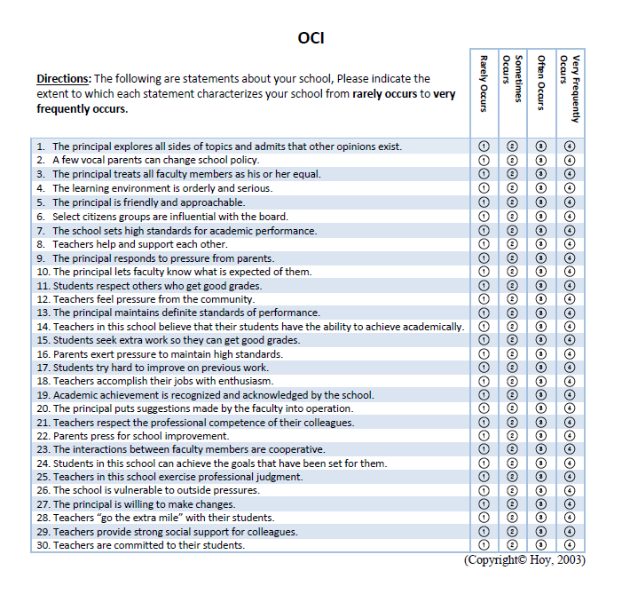
Notes:
Amanda – This instrument is a 30 item, Likert-type scale developed by Hoy, Smith, and Sweetland in 2002. The principal and leadership team of the school used data from the OCI to evaluate climate and create an action plan for addressing concerns identified.

Slide 5
Collegial Leadership
“Directed toward both meeting the social needs of the faculty and achieving the goals of the school. The principal treats teachers as professional colleagues, is open, egalitarian, and friendly, but at the same time sets clear teacher expectations and standards of performance.”
Hoy, Smith & Sweetland, 2002
Notes:
Julie – The OCI instrument is made up of four subscales or dimensions. Collegial leadership refers to how the principal interacts with the teachers and staff. A collegial leader is friendly, supportive, and open with his colleagues, while maintaining specific standards and expectations. This dimensions focuses on principal and teacher interactions.

Slide 6
Professional Teacher Behavior
“Marked by respect for colleague competence, commitment to students, autonomous judgment, and mutual cooperation and support”
Hoy, Smith & Sweetland, 2002
Notes:
Julie – The second area measured by the OCI is professional teacher behavior. Teachers who are professional demonstrate respect for colleagues, and commitment to students and their achievement. They are cooperative and supportive of their colleagues. This dimension considers how teachers interact with each other.

Slide 7
Achievement Press
“Describes a school that sets high but achievable academic standards and goals. Students persist, strive to achieve, and are respected by each other and teachers for their academic success. Parents, teachers, and the principal are exert pressure for high standards and school improvement”
Hoy, Smith & Sweetland, 2002
Notes:
Julie – Achievement Press is the third dimension of the OCI. It is also called Academic Press and describes the school’s academic expectations for students. Do teachers, parents and principals encourage students to do their best and maintain high expectations for success? Do students work hard to achieve good grades? Does the school celebrate academic achievement?

Slide 8
Environmental Press
The extent to which the school is susceptible to a few vocal parents and citizen groups. More pressure from outside forces suggests that both teachers and principals are unprotected and put on the defensive.
Hoy, Smith & Sweetland, 2002
Notes:
Julie– Hoy, Smith and Sweetland define environmental press as how much influence a few parents or community members have over the organization’s decisions and policies. If outside forces exert more pressure, then faculty feel unprotected and put on the defensive. This dimension of the OCI measures the relationship between the school and its community. So, if a school has high environmental press, they perceived themselves as vulnerable to the community and lacking control of policies and decision making. In turn, schools with low environmental press, feel protected from outside pressure and have a healthier school climate.

Slide 9
OCI – Fall 2008
Notes:
Julie - In the fall of 2008, the OCI was administered to the faculty as part of a regularly scheduled faculty meeting. The results, although disappointing for the faculty, confirmed their concerns about the school’s climate.
Collegial Leadership - With a score of 480 Southeast High is very close to the mean of the schools in the normative sample.
For Professional Teacher Behavior, with a score 329, which is more than one and a half standard deviations below the mean, the school is in the bottom 10 % of the sample of high schools that made up the normative sample. Schools like this have unusually low levels of collegial support, commitment to students, and respect for collegial competence.
The 370 on Achievement Press, more than one standard deviation below the mean, puts the school in the bottom 14% of schools that made up the sample. This indicates that teachers do not set high but achievable standards for their students; neither students nor teachers respect the academic success of the students.
Environmental Press – The score of 488 was very close to the mean score of the sample, meaning that almost 50% of schools responded in a similar manner.

Slide 10
Clinical Intervention Strategy:
Diagnosis (Rationale) – review of OCI surveys to assess climate of Southeast High School
Low teacher morale
High behavior/discipline problems
Underachieving students
Poor parent/teacher interaction
Lack of perceived school spirit
Notes:
Amanda - After the principal and Faculty Task Force shared the results with the rest of the faculty, they first diagnosed the problems that created the low scores of the OCI, identifying low teacher morale, high behavior problems, underachieving students, and poor parent/teacher interaction as areas of concern.

Slide 11
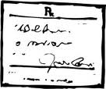
Clinical Intervention Strategy:
Prescription –
Establish faculty task force
Create student task force
Promote academic programs for students
Focus staff development on collaboration and improving class performance
Provide support for struggling students
Develop peer mediation team
Notes:
Amanda - The task force moved to the prognosis step, creating a list of priorities, both long-term and short-term. A course of action was begun with the creation of a student task force to be an offshoot of the main task force and to be the “work horse” for the action plan. The goals set by the Student Task Force were (1) to engage larger numbers of their peers in the process, (2) to increase school spirit and participation in extra-curricular activities, (3) to promote academic programs and recruit more students for advanced placement classes as well as college-entrance assessments such as the ACT and PSAT/SAT, and (4) to create a peer mediation team, sponsored by faculty members but manned primarily by students, in order to help students who had conflicts resolve them in non-violent ways and to give them human relations tools to use not only in school situations, but also in general social interactions.
Another step in the plan involved increasing teacher collegiality and communication. This involved (1) arranging for common time during the school day for professional conversations on best practices, sharing of student progress, and sharing ideas and fellowship; (2) informal opportunities for teacher interaction; (3) participation by teachers in the walk-through observations with the team to reduce the anxiety in the process and increase acceptance and understanding of the overall purpose; and (4) the sharing of specific expectations with the faculty in regards to classroom instruction and professional behavior, and follow up of those increased expectations for academic challenge. Informal evaluations were conducted at each task force meeting through discussion of members’ observations and data derived from discipline reports, standardized test scores, and extra-curricular participation records.

Slide 12
OCI - Spring 2009
Notes:
Julie - After these strategies had been in place for six months, the OCI was administrated again in the spring of 2009. Results indicated that the strategies had made a difference in the teachers’ perceptions of the climate.
Collegial leadership increased from 480 to 492, inching closer to the mean of the sample population.
Professional teacher behavior also increased from 329 to 423, almost a standard deviation unit. The score went from being in the bottom 14% to approximately 30%.
Academic Press went from 370 to 406 which is less than a half standard deviation unit.
Environmental Press increased from 488 to 517 which is above the mean for the normative sample.

Slide 13
Next Steps in the Plan
Commit to continuing strategies
Hold a faculty retreat at the beginning of the next school year
Conduct a faculty “revival” meeting in the middle of the semester
Re-evaluate after a year of implementing the action plan
Notes:
Amanda - With the positive reinforcement from the OCI results, the principal and faculty task force re-evaluated the action plan and developed their next steps.
First, they continued the previous strategies used, including the student task force and its goals, teacher collegiality and communication activities, walk-through observations, opportunities for team building among faculty, and common planning time.
Next, they held a faculty retreat immediately prior to the beginning of the fall 2009 semester. This retreat focused on collaboration, team building, goal setting, and a continued commitment to the previously established strategies.
They conducted a faculty “revival” in the middle of the fall semester at a time when educators historically grow tired and ready for a break. This revival celebrated what had been accomplished and renewed efforts for continuing the plan.
Finally, they administered the OCI once more.

Slide 14
OCI - Fall 2009
Notes:
The third administration of the OCI occurred in Fall 2009.
Collegial Leadership, Professional Teacher Behavior and Achievement Press all increased. Collegial leadership demonstrated the most significant gains.
Environmental Press decreased to more than a standard deviation unit below the norm of the sample population, which is a significant decrease.

Slide 15
Collegial Leadership
Notes:
Julie - A third administration of the OCI then took place in late fall 2009. The results showed that the action plan, now implemented for over a year, had significant impact on school climate.
Collegial leadership improved dramatically from the first to the third administration of the survey. Scores increased from 480 to 583.

Slide 16
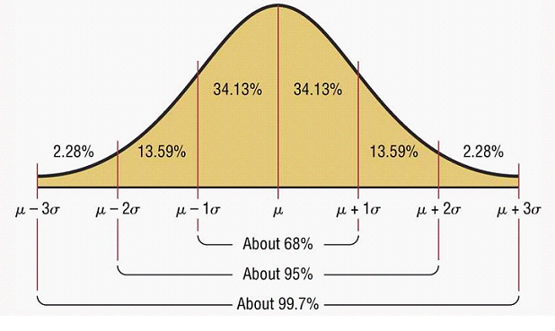
Collegial Leadership
Notes:
Julie - This growth represents a standard deviation unit, which is significant. The score of 583 demonstrates that Southeastern High School is higher than 75% of schools that made up the norm. This is a significant change in teacher perception of collegial leadership. Shared decision making likely contributed to this increase.

Slide 17
Professional Teacher Behavior
Notes:
Julie – climate scores for professional teacher behavior increased from 329 to 466.

Slide 18
Professional Teacher Behavior
Notes:
Julie – Although this is still below the norm, the improvement was significant. In other words more than 40% of the teachers at Southeast High School perceived themselves and their colleagues to be professionals. This represents more than a standard deviation change.

Slide 19
Achievement Press
Notes:
Julie – Scores for achievement press increased from 370 to 446.

Slide 20
Achievement Press
Notes:
Julie – Teachers’ perception of achievement press increased slightly less than a unit of standard deviation within the year of the study.

Slide 21
Environmental Press
Notes:
Julie - Scores for environmental press increased from 488 in fall 2008 to 517 in spring of 2009 and finally decreased again to 375 in fall 2009. This decrease can be interpreted in a positive way as teachers felt protected by the principal and organization from outside pressures. They perceived that their role in shared decision making was legitimate and protected by the principal. They felt less vulnerable and more insulated from external pressure.

Slide 22
Environmental Press
Notes:
Julie – The only dimension to decrease was environmental press. This score tells us that Southeast High Schools falls in the bottom 10% as compared to schools in the normative sample. This decrease could be explained by the teachers’ role in shared decision making and improvements in the school climate. Teachers perceived that the principal would insulate them from external pressure.

Slide 23
Upon Reflection:
Collegial Leadership improved dramatically because of opportunities for leadership for faculty members.
Faculty spent more time focused on academic goals for students and Achievement Press increased.
Professional Teacher Behavior increased as a result of collaborative, shared decision-making.
Environmental Press decreased as faculty felt less pressure from outside forces and more confidence in their decision making.
Notes:
Amanda – The OCI was a key element in identifying climate issues and helping the principal and task force diagnose the problems, prescribe strategies to address those, and evaluate the results of those strategies. Southeastern High School faculty and staff became more aware of how they viewed each other, their students, and outside pressures. They also grew in their professional behavior and in their attitudes toward student achievement and abilities. The study, which lasted over a year’s time, showed that schools can make a difference in climate by using the measurable data obtained through the OCI, identifying areas of focus, applying strategies, and progress monitoring with subsequent administrations of the instrument. Southeastern High School has made a change. As with most initiatives, however, sustainability relies on the continued commitment of the leadership and stakeholders.

Slide 24
References
Halpin, A.W. & Croft, D.B. (1963). The organizational climate of schools. Chicago: Midwest Administration Center of the University of Chicago.
Hoy, W.K. & Sabo, D.J. (1998). Quality middle schools: Open and healthy. Thousand Oaks, CA: Corwin Press.
Hoy, W., Smith, P. & Sweetland, S. (2003). The development of the organizational climate index for high schools: Its measure and relationship to faculty trust. The High School Journal, 86(2), 38-49.
Hoy, W. K., & Miskel, C. G. (2008). Educational administration: Theory, research, and practice (8th ed.). New York: McGraw-Hill.
Parsons, T. (1967). Some ingredients of a general theory of formal organization. In A.W. Halpin (Ed.), Administrative theory in education (pp. 40-72). New York: Macmillan.
SACS Self Study (2005-2006). Unpublished manuscript, - - - - High School.
SASI Management System (2003-2004). [Discipline report]. Unpublished raw data.
STI Office Software Technology, Inc. (2004-2008). [Average daily membership]. Unpublished raw data.
STI Office Software Technology, Inc. (2004-2008). [Discipline report]. Unpublished raw data.
Yukl, G. (2002). Leadership in organizations (5th ed.). Upper Saddle River, NJ: Prentice Hall
Notes:
Papers available for audience – answer questions as discussant allows for such.

